Slide 1
Bank Marketing
Presented By
Yuvaraj Reddy Sanagala

Slide 2
Contents
Overview
Data Source
Data Visualization
Imputation
Correlation and Log Transformation
Cato Encoding and P-values
Balancing and Data Partition
Feature Selection
Data Dictionary
Importance of Features
Model Performance
Receiver Operating Characteristic Curve
Conclusion and Future Work
References

Slide 3
Overview
Problem Statement:
To predict whether the client will do a term deposit with the financial institution or not after a marketing campaign.
Solution:
Two types of dataset(flagged and unflagged)
Two types of models (logistic regression & decision tree)
Applications:
Spreadsheet Program: Excel
Programing Language: Python – Extraction and Processing library (Pandas, graphviz), Machine Learning Libraries (Sklearn , Feature_engine, Mlxtend, Imblearn)
Conclusion:
Based on our solution we came up with 4 models, compared them using the performance metrics and we found out that decision tree models were the best for our problem statement.
Notes:
Problem:
The main ideology of our project is to predict a term deposit from a client after a marketing campaign.
Solution:
So, for this first, we have analyzed the data on excel. After analyzing we found that there is a necessity in dividing the data into two types of datasets flagged and unflagged as certain features in the dataset can affect an organization. Next, we have selected the best features from our dataset. Later we have preprocessed our data and selected more than half of our variables as best features for our model. Finally, we have built two types of model's logistic regression and decision tree and found out the performance of each model.
Applications:
The first application program which we used was a Spreadsheet program called Excel for analyzing purposes.
Next, we used the pyhton programming in a spyder environment to perform required operations.
The libraies which we used are as follows:
Pandas: to extract and process data
Graphviz: to create decision tree
Next the machine learning libraries:
Sklearn: which was used to build models and their performance.
Feature_engine: for encoding purpose
Mlxtend: for the selection of features for each model using the respective estimators.
Imlearn: It is used to balance of our dataset as we have some uncertainty in our target.
Conclusion
Based on our solution we came up with 4 models and compared them for performance. The performance was analyzed by selecting metrics such as accuracy, sensitivity, specificity, f1 score and Roc curve.

Slide 4
Data Source
Source:
UC Irvine Machine learning repository
Link:
https://archive.ics.uci.edu/dataset/222/bank+marketing
Dataset Details:
Dataset Name - Bank Telemarketing
Financial Institution - Banco de Portugal
Dataset Timeline - May 2008 - Nov 2010
Dataset Size - 41188 rows, 20+ 1 target columns
Types of Data - Numeric – 10, Categorical – 6, Binary – 4 +1 target
Dataset Type - Imbalanced data
Notes:
We created a doughnut graph to show the imbalanced data for target named deposit.
From the graph we can say that our target is not evenly distributed.
In our case we can see that we have a total of 11% of case where client do a term deposit and 89% of the cases the client do not deposit.
So, this may create a problem while creating the model.
So, in the future slides we will discuss how we will tackle this problem to any avoid issue while creating a model.

Slide 5
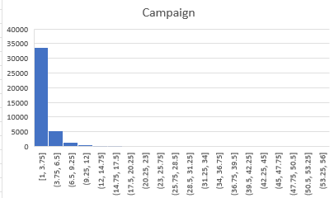
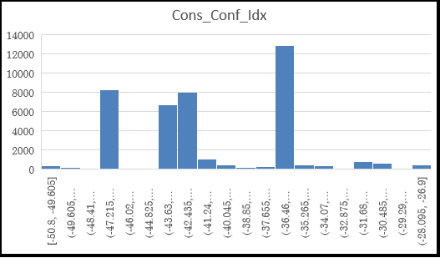
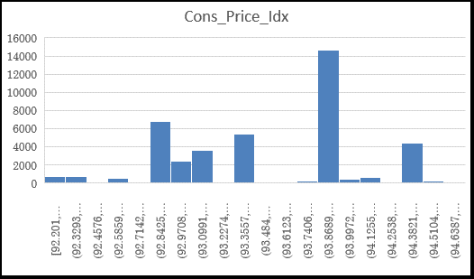
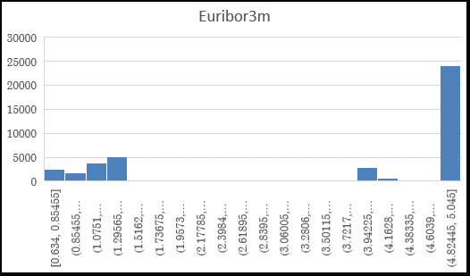
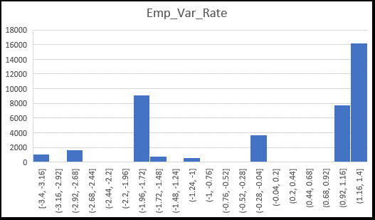
Data Visualization
Notes:
The first step we have done after taking the dataset is that we decided on the most important features which can affect the model.
So next we have created histograms to check how these features perform
The first important features which we considered is Campaign.
So, we checked the total number of campaigns done for a certain number of times
Next, we considered socio and economic features :
First one is Cons_Conf_Idx: which provides us with details about the degree of optimism of consumers regarding current and expected economic conditions from the time of May 2008 - Nov 2010 this was monthly indicator.
Second one is euribro3m: which provides us with details about Reference rate that is constructed from the average interest rate from the time of May 2008 - Nov 2010 this was quarterly indicator.
Third one is Cons_Price_Idx: which provides us with details about Measures the degree of optimism of consumers regarding current and expected economic conditions from the time of May 2008 - Nov 2010 this was monthly indicator.
Last one is Emp_Var_Rate: which provides us with details about Measure of the average change over time in the prices paid from the time of May 2008 - Nov 2010 this was monthly indicator.
Finally, we would like say that these socio and economic factors play a key role in our modeling as our main goal is to get the deposits.

Slide 6


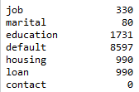
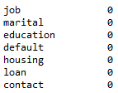
Imputation
Flagged:
- Eliminated
- Binary
- Numerical
- Categorical
- Target
Mode - As Categorical Features have Null entries
Columns = 15 + 1 Target
Features with Null Entries
Imputation Technique
Features with Null Entries
Unflagged:
Mode - As Categorical Features have Null entries
Columns = 19 + 1 Target​
Imputation Technique
Features with Null Entries
Features with Null Entries
Notes:
Color scheme
Red- eliminated
Yellow- Binary
Blue- numerical
Orange- categorical
Green - target
As we previously mentioned we have created two types of dataset 1. Flagged 2. unflagged
We have flagged certain features which we considered discriminatory as per the business norms such as Job, Marital, education, Age etc .
Unflagged dataset is the entire dataset without flagging.
However, there is a special variable that has been eliminated in both cases and that is ‘Duration’. As the duration is not known before a call is performed and after the end of the call y is obviously known as it impacts the target.
Null entries
As the second step of our preprocessing we have found out the total number of null entries in each of the datasets and we have imputed these null values with mode because our null entries are from categorical features.

Slide 7
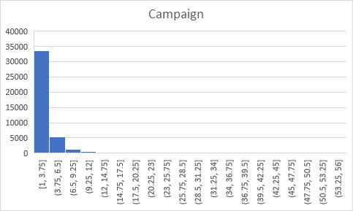
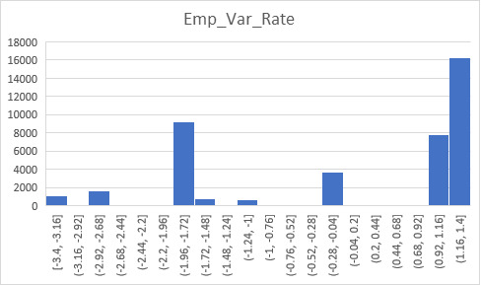
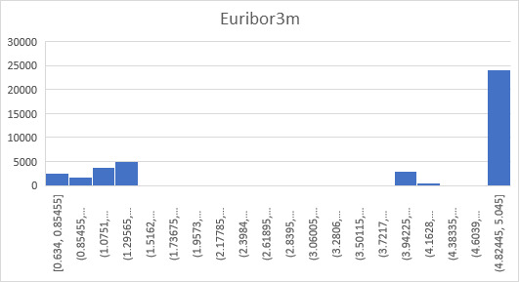
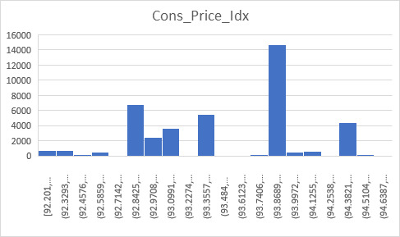
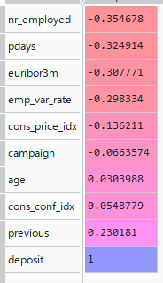
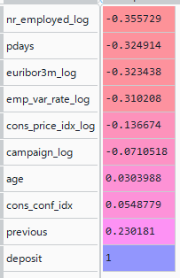
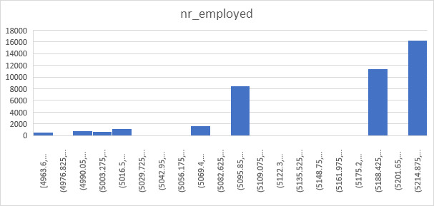
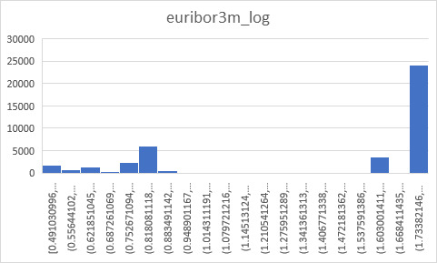
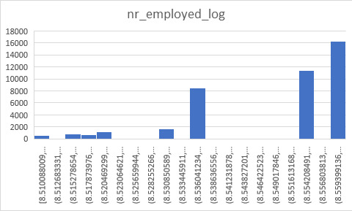
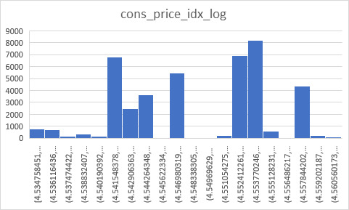
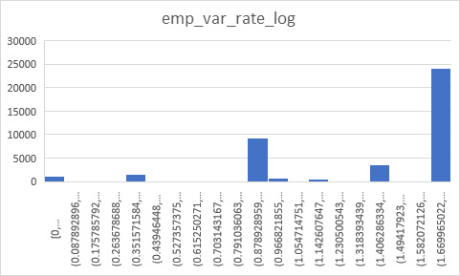
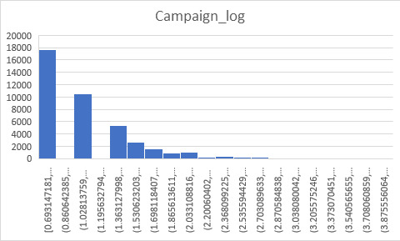
Correlation And Log Transformation
Correlation
Correlation Log
Log Transform Formula and Features:
Log(x+1) - nr_employed, Campaign, euribor3m, cons_price_idx
Log(x+1-min(x)) - emp_var_rate
Notes:
As we have both numerical and non-numerical variables, we have decided to select our features separately using 2 types of methodologies:
Correlation for the numerical variables.
Chi-square for non-numerical.
Firstly, we found out the correlation of both the datasets as shown, then we considered our correlation threshold as > 0.5. However, we found out that all of our correlation for variables is less than the threshold.
As a result of this we are unable to eliminate the variables.
As, per our data analysis we found that certain features have skewness so, we have applied the log transform for these features. However, we found that there was not much of a variation when compared with the graphs. So, we also used the correlation to check the change.

Slide 8
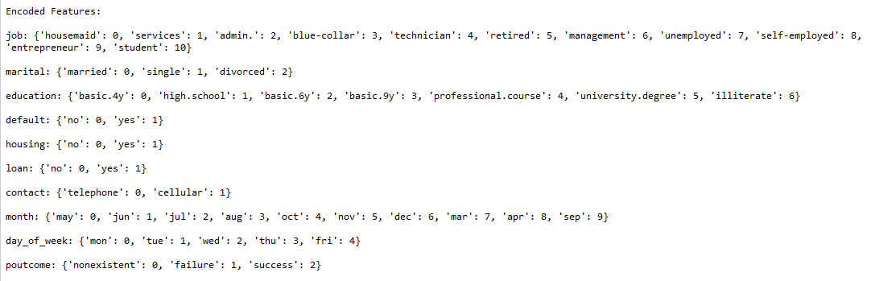
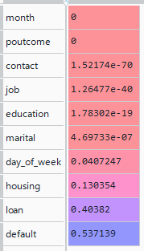
Cato Encoding and P-values
P-Values
Categorical Features Dictionary after Encoding​​
P-Value threshold which in general used to eliminate Categorical features
P-Value >0.05
Features Eliminated – Housing, Loan, Default
Flagged Dataset Size
Original
Columns = 15 + 1 Target
Reduced
Columns = 12 + 1 Target​​
Unflagged Dataset Size
Original
Columns = 19 + 1 Target
Reduced
Columns = 16 + 1 Target​​
Notes:
The first step of this data pre-processing is converting the non-numerical into numerical, for this we used the Ordinal Encoder from the Encoding library of the Feature_engine library. The results for the encoding features are as shown.
After conversion we used chi-square technique from the Feature selection library of the SKLearn library to find out the P-values for different features.
Later we eliminated the features using a threshold for the P-values. The threshold which will be in general used is >0.05 as, a result we will eliminate the housing loan and default feature from both of our datasets

Slide 9
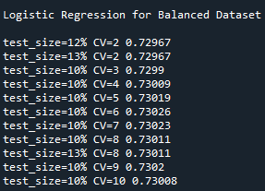
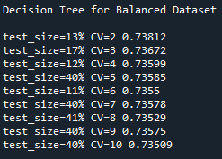
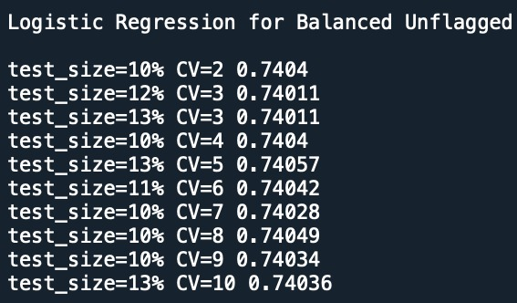
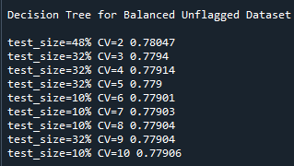
Balancing and Data Partition
Before Oversampling
Sampling Method - Oversampling
After Oversampling
Rows - 41188
Oversampling Type - Synthetic
Rows - 73096
Technique - Machine Learning Algorithm
Library - SMOTE
Train Size and Cross Validation
Train Size = 87, CV=5, CV Score= 0.74057
Train Size = 52%, CV=2, CV Score= 0.78047
Train Size= 90%, CV=6, CV Score= 0.73026
Train Size = 87%, CV=2, CV Score= 0.73812
Notes:
The last step for our data pre-processing is balancing the dataset.
In general, we have 2 methods to balance a dataset which are:
Oversampling – it is process of increasing the minorities
Under sampling – it is process of decreasing the majorities
For our dataset we decided to use the oversampling as we won't lose the accuracy of the information. However, we have 2 types of oversampling methods:
Random – it is the process of adding the rows randomly
Synthetic - it is the process of adding the rows based on the algorithm by using the present dataset
So, in our case we are using the synthetic method to generate the data by using Machine Learning Algorithm.
For this we are using smote from the over_sampling library of the Imblearn library.
After this the first process before creating any model is to make sure that we are not overfitting.
So, for that we decided to find the best train size and best K-fold for our models.
For that we used the train test split, K fold and cross validation variables from the model selection library of the sklearn library.
Next, we applied looping method to find the best K fold and test size.
For that we have varied the K fold from 2 to 10 and test size varying from 10 to 50.
To get the best result we used the average cross validation score. Before we go to the next step lets briefly discuss the average cross validation score.
The average CV is a technique which calculates the accuracy for k times by taking K-1 folds for train and 1 for test in a repeated manner each time with a different train and test sets.
Next an average of these accuracies is calculated.
After, we found out the average cross validation scores for different range of folds and for different range of test size we found out the best score with the test size and k fold in each k fold and finally we decide on one of the case based on Cross value score as shown.

Slide 10
Feature Selection
The next step of creating a model is Feature Selection
Feature Selection Method – Floating Forward (Similar to Stepwise)
Technique - Machine Learning Algorithm
Features Selected Based on Datasets
Flagged – 7 Features
Unflagged – 9 Features
Logistic Regression Flagged
'month', 'pdays', 'cons_conf_idx', 'nr_employed_log', 'campaign_log', 'emp_var_rate_log', 'cons_price_idx_log’
Logistic Regression Unflagged
'job', 'marital', 'month', 'day_of_week', 'poutcome', 'pdays', 'cons_conf_idx', 'campaign_log', 'euribor3m_log'
Decision Tree Flagged
'contact', 'day_of_week', 'poutcome', 'pdays', 'cons_conf_idx', 'emp_var_rate_log', 'euribor3m_log’
Decision Tree Unflagged
'job', 'marital', 'education', 'day_of_week', 'poutcome', 'campaign_log', 'emp_var_rate_log', 'euribor3m_log', 'cons_price_idx_log'
Notes:
The next important process is finding the best features to build a model.
For this we used the Sequential Feature Selector variable of feature selection library of the mlxtend library.
Next, We use the floating forward for feature selection – Floating Forward (It is a process in which first a feature is added to subset and then removed if the performance of the feature is not good along with other feature it is like that of stepwise method in SAS EM)
Next, we used the test size and CV from the previous analysis and selected the features.
In our case as we have four models, we have selected 7 best features from flagged dataset and 9 best features from unflagged dataset as shown.

Slide 11
Data Dictionary
The Data Dictionary for the most important features which we previously selected are defined in the below table.
Feature Name | Type | Description
campaign | Numeric | Number of contacts performed during this campaign and for this client
cons.conf.idx (monthly indicator) | Numeric | Measures the degree of optimism of consumers regarding current and expected economic conditions
cons.price.idx (monthly indicator) | Numeric | Measure of the average change over time in the prices paid by urban consumers for a market basket of consumer goods and services.
day_of_week | Categorical | Last contact day of the week
education | Categorical | Degree of education completed
emp.var.rate (quarterly indicator) | Numeric | It is the percentage of the population that is currently working.
Euribor3m (quarterly indicator) | Numeric | Reference rate that is constructed from the average interest rate
pdays | Numeric | Number of days that passed by after the client was last contacted from a previous campaign
poutcome | Categorical | Outcome of the previous marketing campaign

Slide 12
Importance of Features
Decision Tree Flagged
Decision Tree Unflagged
Feature | Log Odds |  | Importance
 | LR Flagged | LR Unflagged | DT Flagged | DT Unflagged
cons_price_idx_log | 7789314.8193 |  |  | 0.031
month | 1.1115 | 1.101
cons_conf_idx | 1.0045 | 1.0253 | 0.2133
pdays | 0.9981 | 0.9957 | 0.028
campaign_log | 0.8416 | 0.8043 |  | 0.26
emp_var_rate_log | 0.2577 |  | 0.6721 | 0.0113
nr_employed_log | 0.0003
job |  | 0.9903 |  | 0.0
day_of_week |  | 0.8999 | 0.0 | 0.0176
marital |  | 0.7019 |  | 0.0
poutcome |  | 0.2173 | 0.0 | 0.0151
euribor3m_log |  | 0.1677 | 0.0829 | 0.665
contact |  |  | 0.0038
education |  |  |  | 0.0
LR – Logistic Regression
DT – Decision Tree
Notes:
After we found out the best features the next step is to find the importance of each feature in case of each model.
Based on that we have made a list of features with their respective importances based on type of model.
Incase of Logistic Regression we considered the log odds and incase of decision tree we considered the feature importance.
From the data we can say that the cons_price_idx_log plays a crucial role when compared to other features for Logistic regression flagged data.
It is observed that if there is a unit increase in cons_price_idx_log will increase the chances of deposit by 7789314.8193. In the similar way for remaining.
Next in case of Unflagged the month plays a key role.
Next incase of decision tree the emp_var_rate_log acts as a major feature in case of flagged and in case of unflagged the euribor3m_log act as a major feature. These can be seen using the decision tree.
Decision Tree:
The general parameter which we used to create our decision tree is Gini
The chart was created using the Graphviz by using the dot data

Slide 13
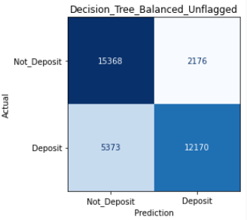
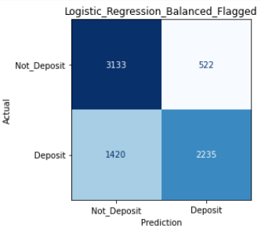
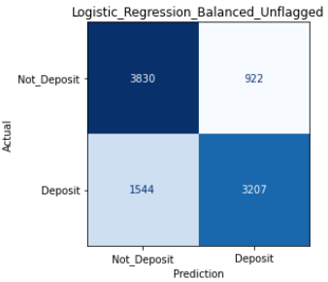
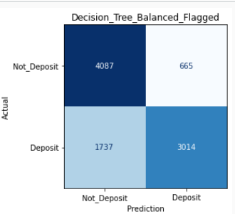
Model Performance
F1 Score =(2*Precision*Sensitivity)/(Precision + Sensitivity)
Metrics | Logistic Regression Flagged | Logistic Regression Unflagged | Decision Tree Flagged | Decision Tree Unflagged
Accuracy
Precision
Sensitivity
Specificity
F1_Score
0.73434
0.81066
0.61149
0.85718
0.69713
0.7405
0.7767
0.67502
0.80598
0.7223
0.74724
0.81924
0.63439
0.86006
0.71507
0.78485
0.8483
0.69372
0.87597
0.76327
Decision Tree Unflagged > Decision Tree Flagged > Logistic Regression Unflagged > Logistic Regression Flagged
Notes:
The performance of our models are decided by certain important metrics as shown in the table.
The first factor which we considered is the Accuracy and we can say that the best of all models is decision tree unflagged.
Next important metric is precision, and this metric plays a crucial role in our problem. In our case our False positives should be as small as possible.
So that we will not predict any errors in deposit.
As deposits can affect a financial institute in many ways such as providing loans, trading and more.
As per this metric the best model is Decision Tree unflagged.
Next, we also need to make sure our False negative is small as possible.
So based on this we can say the Sensitivity of Decision Tree Unflagged is good.
Next as per our data we also need to predict the True negatives and as per this we can say that the Decision Tree Unflagged is better based on Specificity.
Finally, we consider a new metric which is useful when it is difficult to decide which of the parameter need to be considered, whether a FP or FN plays a major role for this we used the metric called F1_score.
This metric is a harmonic mean of the precision and sensitivity, and this value should be high to get a good model.
Based on this we can say that the Decision Tree Unflagged and as a conclusion we can say the best overall model is Decision Tree Unflagged.
Next it is for Decision Tree Flagged in all cases.

Slide 14
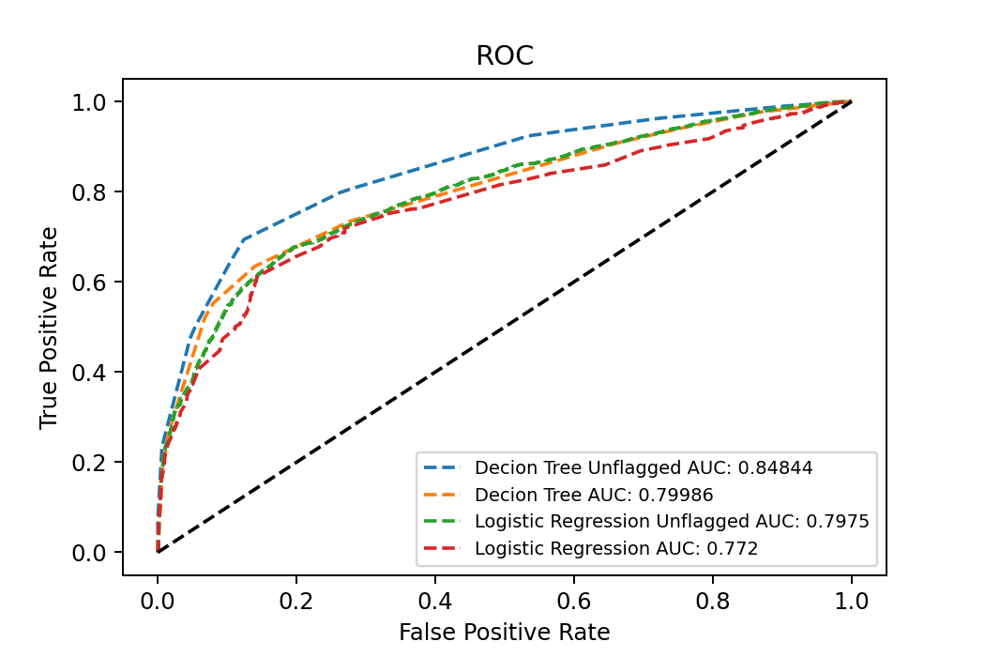
Receiver Operating Characteristic Curve
AUC – Decision Tree Unflagged > Decision Tree Flagged > Logistic Regression Unflagged > Logistic Regression Flagged
Notes:
Until now we have seen different metrics to decide the best model to predict a term deposit.
However, these metrics give us an overall performance of different model.
So, we are unable to decide the performance of model based on classes.
As reason of fact, we devised a new strategy which can help us in determine the model performance based on the classes. For this we used the ROC curves of find the probability of depositing in each case.
As per the ROC curve and Area under curve we found out that probability of predicting a client doing a term deposit is more in Decision Tree Unflagged as shown.
Next it is for Decision Tree Flagged.

Slide 15
Conclusion and Future Work
Conclusion
The best model in General Perspective – Decision Tree Unflagged
The best model in Business Perspective – Decision Tree Flagged
Accuracy, Precision, Sensitivity, F1 Score
Decision Tree Unflagged - 0.78485, 0.8483, 0.69372, 0.76327
Decision Tree Flagged - 0.74724, 0.81924, 0.63439, 0.71507
Important Features - emp_var_rate (Decision Tree Flagged) , euribor3m_log (Decision Tree Unflagged)
The probability the model depicts a term deposit in terms of AUC
Decision Tree Unflagged – 0.84844
Decision Tree Flagged– 0.79986
Future Work
Different Features – That has good relationship with target
Different Models – Random Forest, K Nearest Neighbor
Different Imputation Method - Machine Learning Techniques (K-Means, Hierarchical Clustering)
Notes:
Finally, we would like to conclude that, there are two models which we selected as our best models.
The first one is Decision Tree Unflagged based on general perspective which means by considering all the features and selected best 9.
Next in case of a business perspective we have also selected the Decision Tree Flagged by consider only the features which are best based on the business norms and which are not discriminatory and selected the best 7.
The main metrics which helped us in identifying these models are accuracy, Precision, Sensitivity, F1 Score and AUC. The values for each are as shown.
However, we felt a small dissatisfaction with our models as we only used two types of model.
So, in future we decided to verify our datasets with different models such as Random Forest and K Nearest Neighbor.
Next, we found that the imputation method which we used for categorical is not a good approach. So, we decided to use a different method such as Machine Learning Technique such as K-means or Hierarchical Clustering.

Slide 16
References
SKLearn Library
MLXtend Library
Feature Engine Library
Graphviz Library
Treating Missing values Categorical Variables
Best Imbalance Method
Imabalance Dataset Handling Python
Crossvalidation
Performance Metrics
ROC and AUC

Slide 17

Thank You
Any Question ?

Slide 18
Appendix

Slide 19
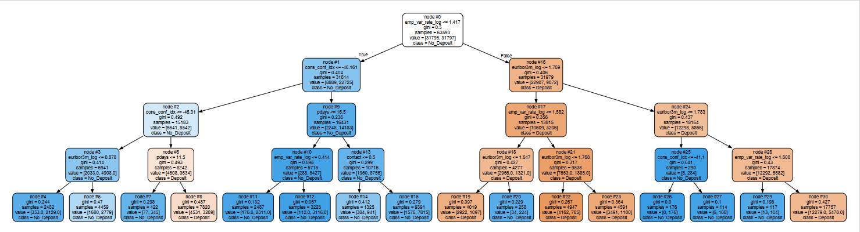
Decision Tree Flagged

Slide 20
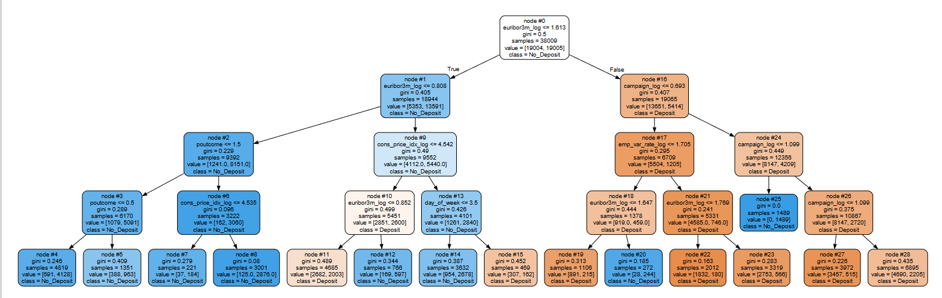
Decision Tree Unflagged

